Slide 1

The 2017 Annual MA TRIZ (International TRIZ Association) China Conference
2017.5.6-7
Shenzhen
By：
MATRIZ（International TRIZ Association）
Shenzhen Intellectual Property Society
Taiwan Innovation Development Associatoin
HK Innovation Society

Slide 2
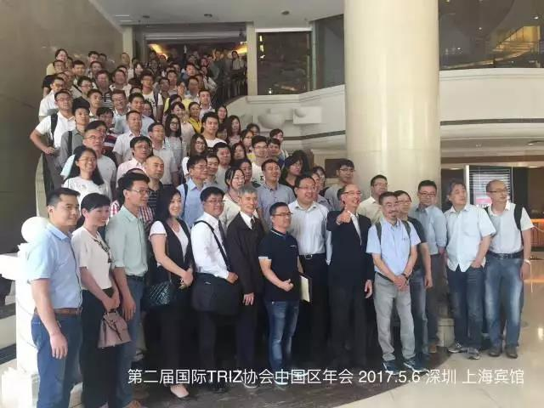
General Information
Great China
China Mainland
Taiwan
Hong Kong
Language
Chinese
Agenda
1st day: Conference
2nd day: Case sharing
Participants
Conference: >170
Case sharing: >80

Slide 3
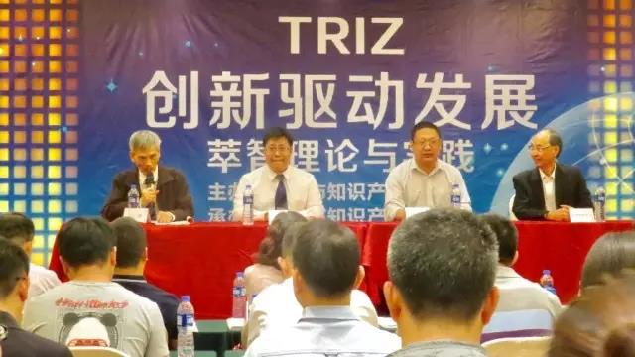
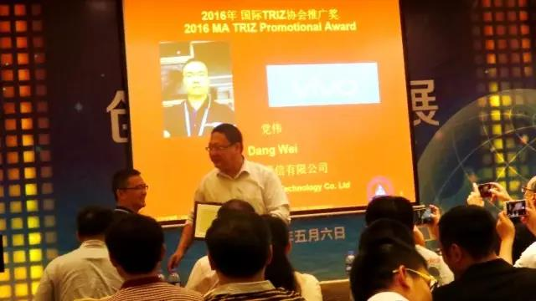
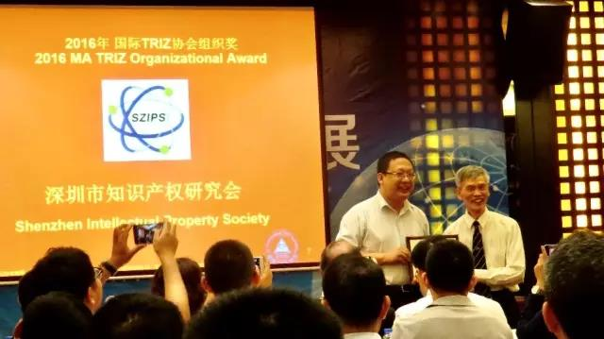
Opening ceremony
Letter from MATRIZ president
Greeting words
Mentioned the society
Awards
Vivo
SZIPS
Sponsored by Shenzhen Science and Technology Bureau

Slide 4
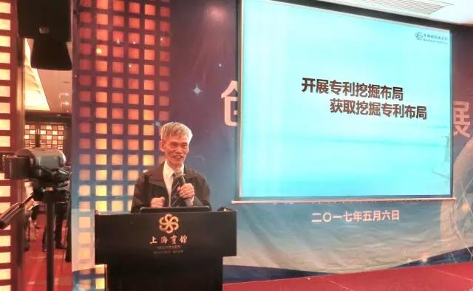
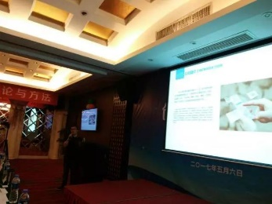
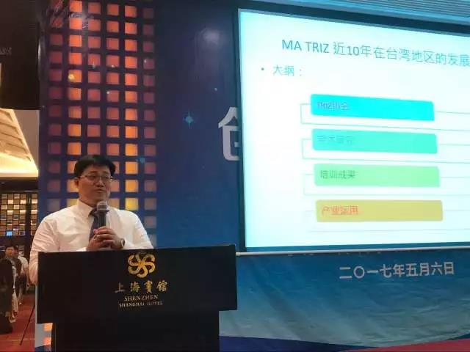
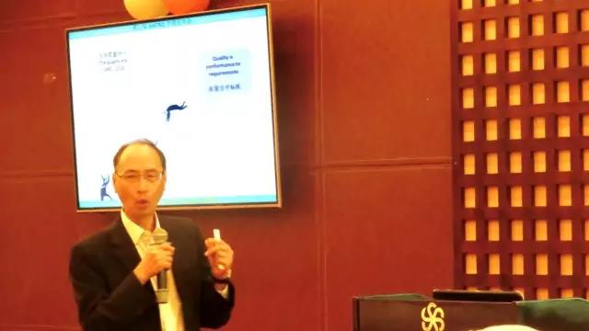
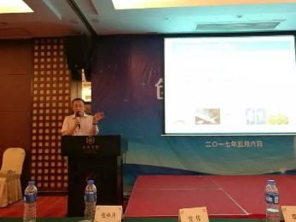
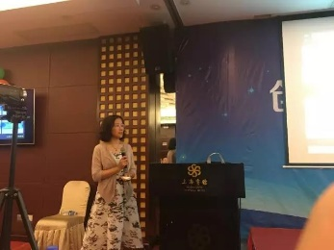
11 Presentations
Recent progress in TRIZ community (Yongwei Sun)
TRIZfest 2016 update
TRIZ New Assumption by Simon Litvin
TRIZ progress in China and strategies
TRIZ in great China
TRIZ in Taiwan (Jeffery Chow) and HK(Victor Lo)
TRIZ in companies
Vivo(Dang Wei), China Railway Institute (Li Xiaoyuan)
TRIZ in Universities
Beijing Institute of Graphic Communication(Li Yan), Shaanxi Normal University(Zhongyue Zhang)
TRIZ Research
CECA application(Luo Jia), TRIZ and Sun Zi Warcraft(Binbin Zhang), Initial Disadvantage Identification(Yongwei Sun)
TRIZ and patents
TRIZ Review(Zhang Zhongyue)
Patent circumvention(Yin Hanfan)

Slide 5
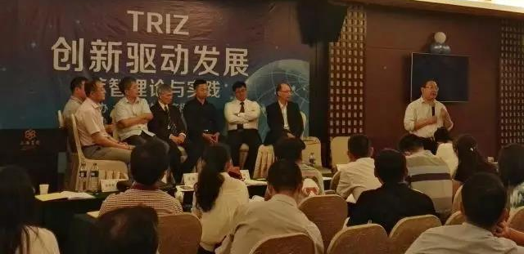
Panel discussions
All presenters
Topics
How to promote TRIZ in companies
How to combine TRIZ with patents
How to apply TRIZ in real projects
Specific TRIZ tools

Slide 6
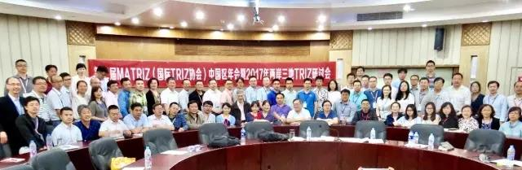
Case sharing
Background
TRIZ is good, but …
Remove the concerns if TRIZ can be used in real projects
Free for presenters, discount for MATRIZ certified
16 cases
TRIZ in companies
Chemical(2), Steel (2), railway(1), appliance(1), electronics(2), equipment development(1)
TRIZ in universiteis
Fundamental research (1), printing(1), students(2)
Patent strategies
Circumvention (2), patent deployment(1)

